Slide 1
Homologous & Analogous Structures
(5) Webquest
2013

Slide 2
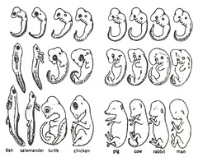
Comparative anatomy
provides evidence of evolution because it shows that various organisms share a common ancestor.
http://cyemae.wordpress.com/evolution-of-man/

Slide 3
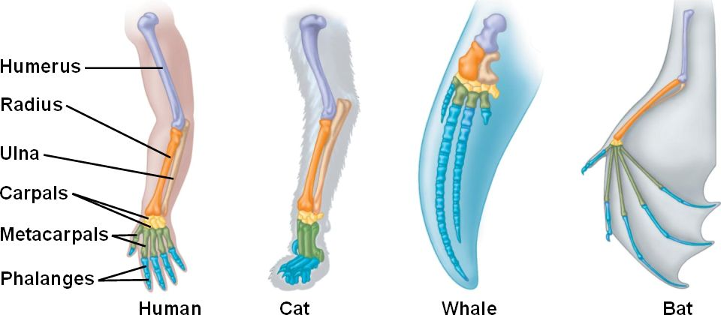
Homologous structures
Share an ancestor
Similar structure
different functions.
http://bio1151.nicerweb.com/Locked/src/chap22_q.html

Slide 4
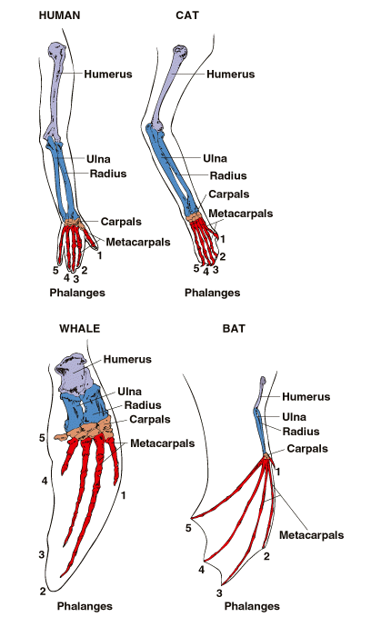
Examples of homologous structures:
whale’s flipper
cat’s leg
bat’s wing
human’s arm.

Slide 5
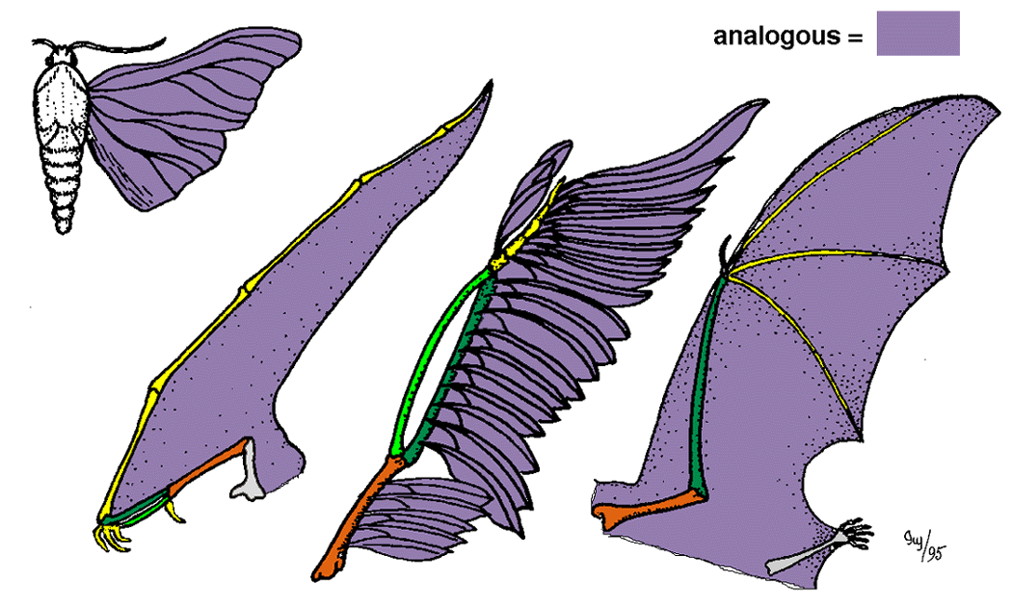
Analogous structures
Same functions
Different structure
do not come from the same ancestor
http://www.bio.miami.edu/dana/106/106F05_4.html

Slide 6
HOMOLOGOUS | ANALOGOUS
Same structure Same ancestor Different function | Same Function Different structure Different Ancestor

Slide 7
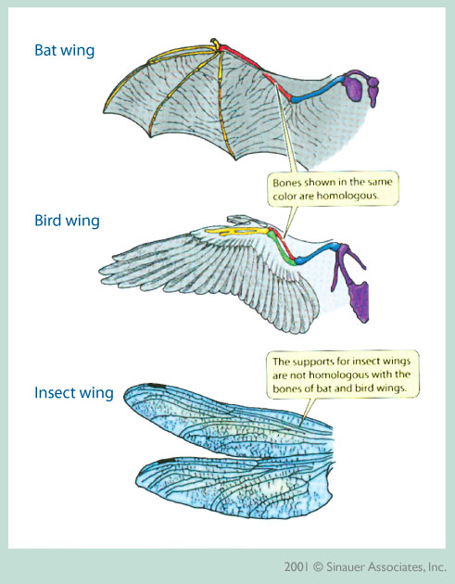
Examples of analogous structures:
insect’s wing
bird’s wing
bat’s wing

Slide 8
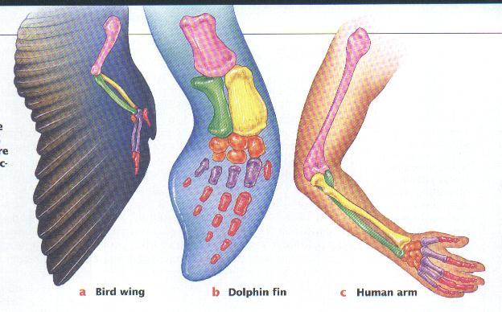
Use the binder to answer the question on your handout. Work together!!!You must finish today

Slide 9
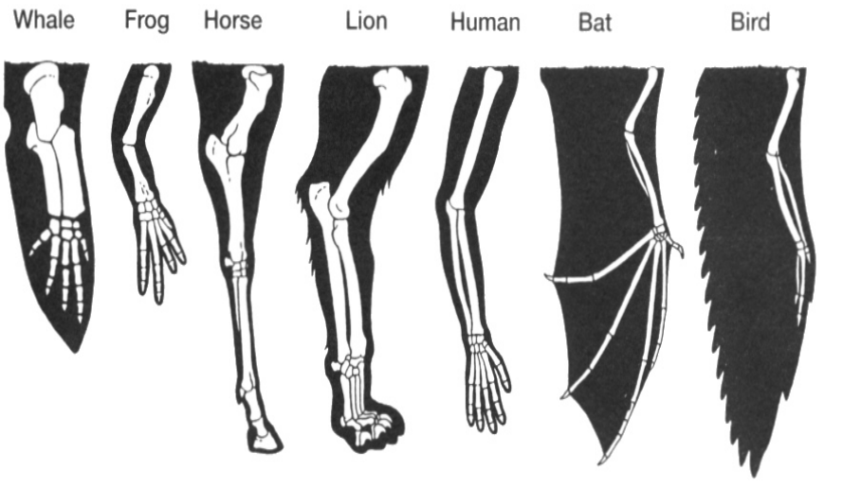

Slide 10
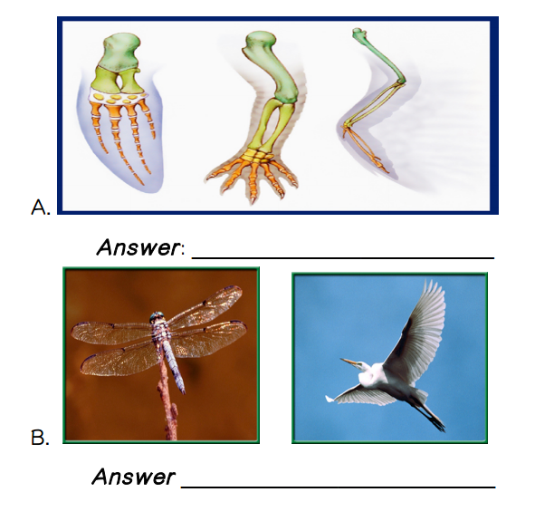

Slide 11
Decide if the following examples are homologous or analogous…

Slide 12
Example A
HOMOLOGOUS or ANALOGOUS

Slide 13
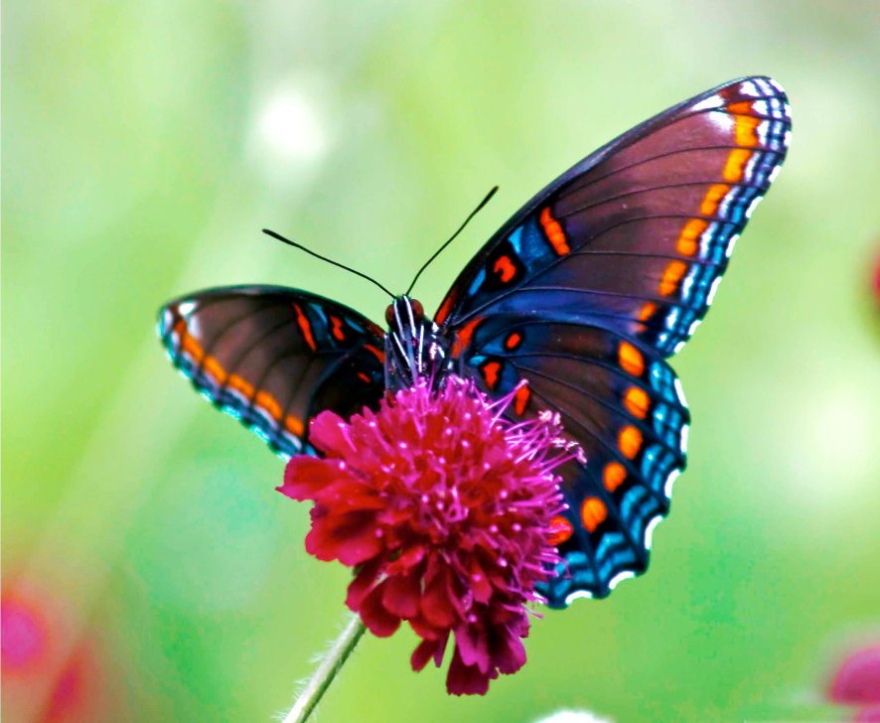
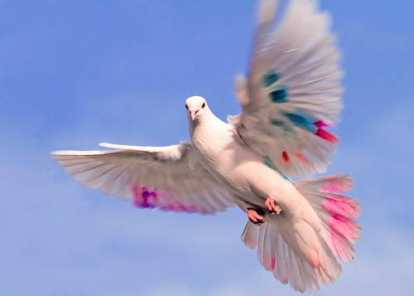
Example B
HOMOLOGOUS or ANALOGOUS

Slide 14
Example C
Evolved from the same ancestor but now have different functions.
HOMOLOGOUS or ANALOGOUS

Slide 15
Example D
Evolved from different ancestors, but because they were placed in the same environment, they have the same function.
HOMOLOGOUS or ANALOGOUS

Slide 16
Example E
A poisonous spider and a poisonous snake both have venom sacs.
HOMOLOGOUS or ANALOGOUS

Slide 17
Example F
A whale and a fish both have fins to swim underwater, however a whale is a mammal and a fish isn’t.
HOMOLOGOUS or ANALOGOUS

Slide 18
Example G
A house cat and a lion evolved from the same ancestor, but no longer look alike (the house cat is much smaller than the lion).
HOMOLOGOUS or ANALOGOUS

Slide 19
Attach homologous handout to the back of page 56.
HOMEWORK-Read the handout…answer questions on a separate sheet of paper.

Slide 20
Draw this chart in your notebook…
Animal | # of bones in upper limb | # of bones in lower limb | Function of the limb (what does it help the organism do?)
Frog front leg
Whale flipper
Horse front leg
Lion front leg
Human arm
Bat wing
Bird wing

Slide 21
Conclusions: Answer the following questions in complete sentences:
How are the limbs of the frog, whale, horse, lion, human, bat, and bird the same?
How are the limbs of the seven animals different?
Are these limbs examples of homologous or analogous structures?
Explain your answer to number 3.
What is the difference between a homologous structure and an analogous structure?

Slide 22
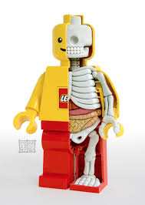
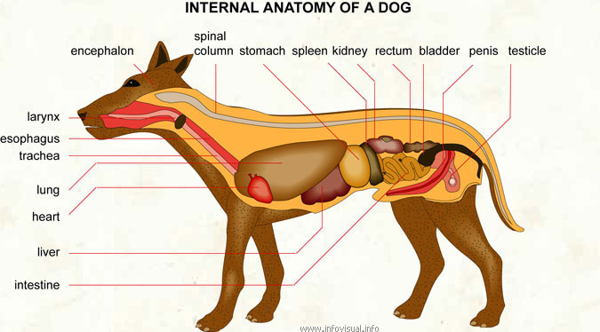
Anatomy
is the study of the structure, or parts, of an organism.
http://www.infovisual.info/02/069_en.html
http://laughingsquid.com/lego-minifigure-anatomy-sculpture-by-jason-freeny/

