Slide 1
MIXTURES

Slide 2
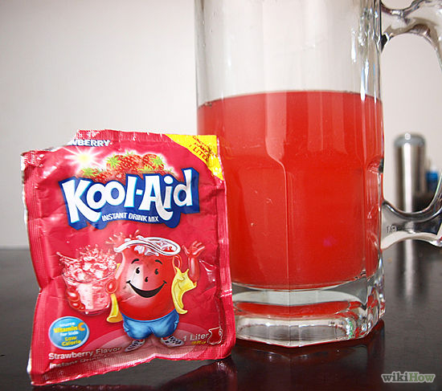
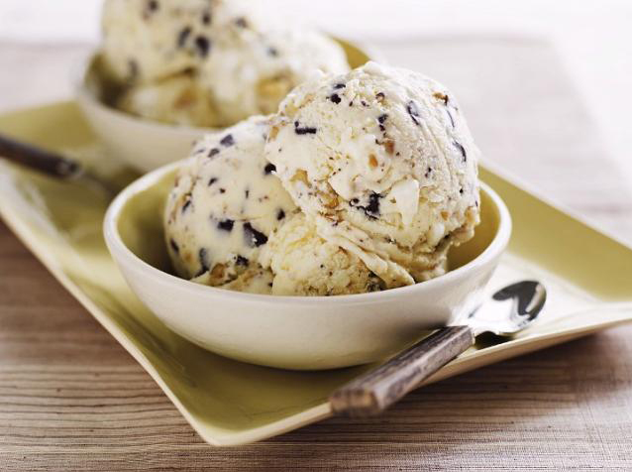
Mixtures…back of page 22
Combination of two or more pure substances that are NOT chemically combined.
No specific Ratio
The parts retain their identity

Slide 3
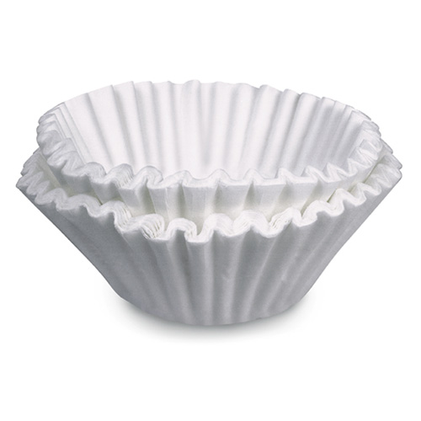
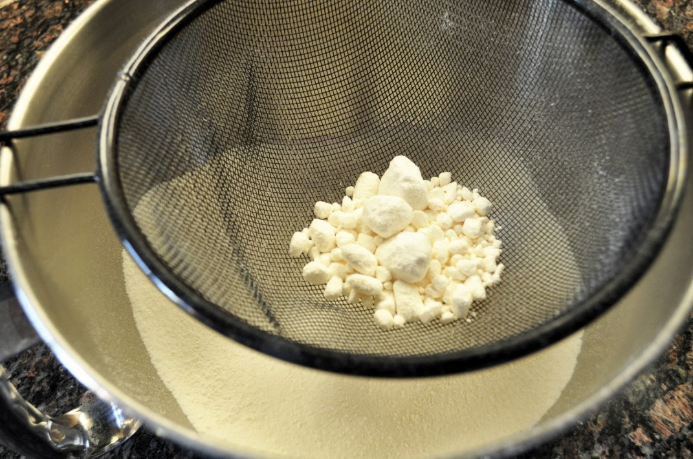
Easily separated(filtration, evaporation, sifting)

Slide 4
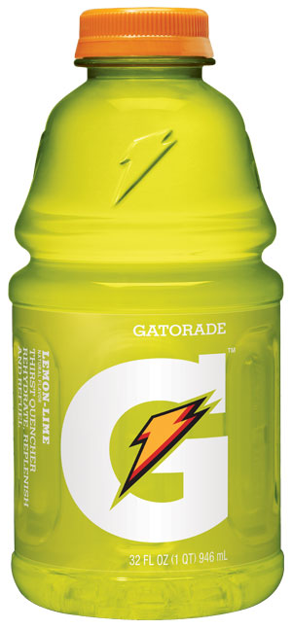
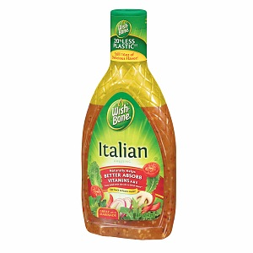
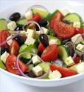
Heterogeneous- looks different
Homogenous-looks the same throughout

Slide 5
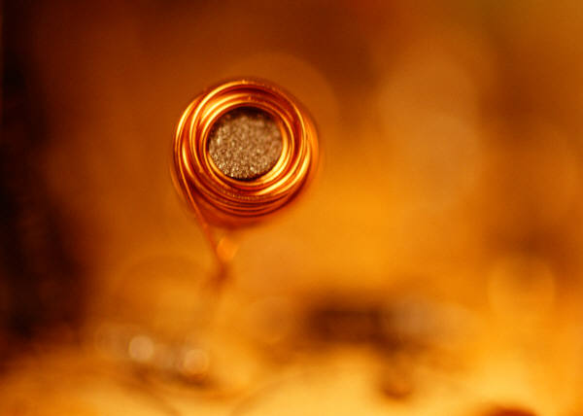
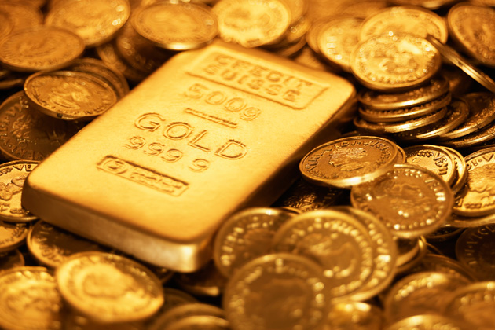
Element, Compound, or Mixture?

Slide 6
Element, Compound, or Mixture?
Au

Slide 7
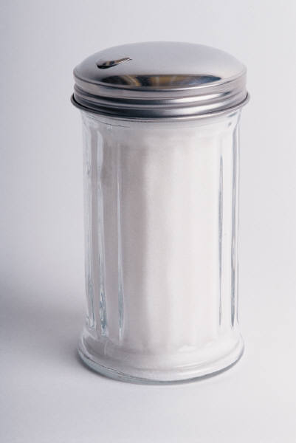
Element, Compound, or Mixture?
Table Sugar

Slide 8
Element, Compound, or Mixture?
Table Sugar
C₆H₁₂O₆

Slide 9
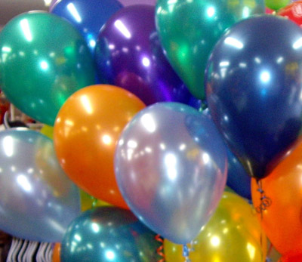
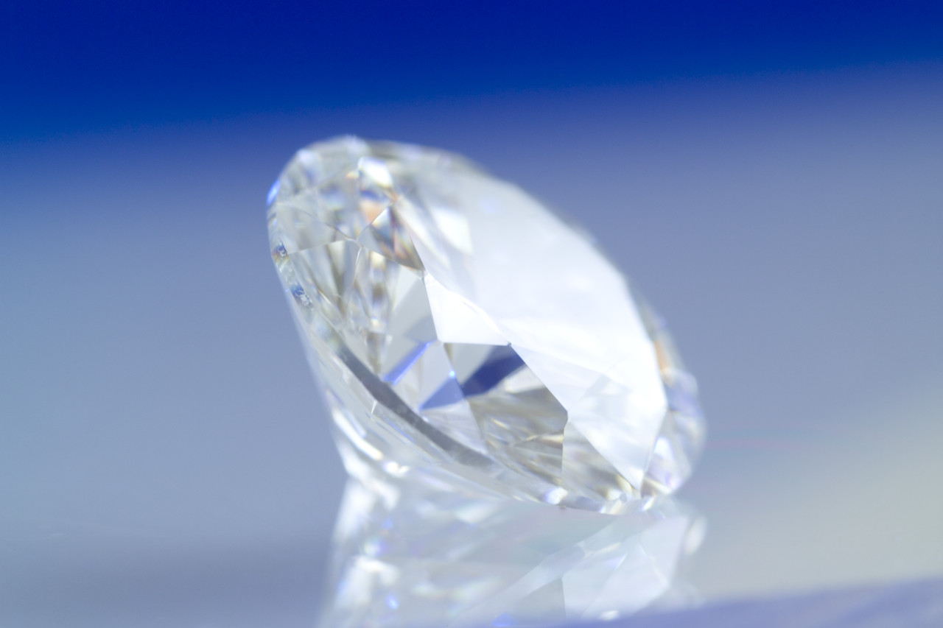
Element, Compound, or Mixture?
helium

Slide 10
Element, Compound, or Mixture?
helium
_{He}

Slide 11
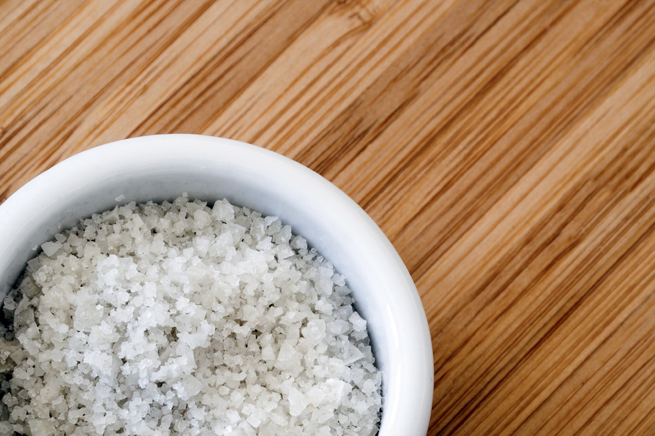
Element, Compound, or Mixture?
Salt

Slide 12
Element, Compound, or Mixture?
NaCl
Salt

Slide 13
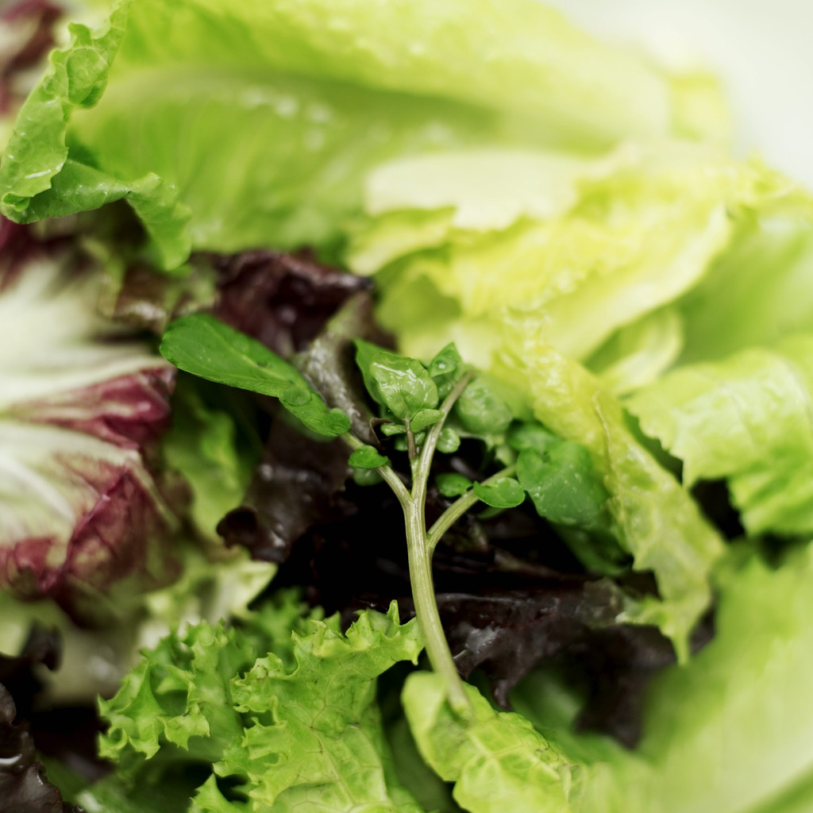
Element, Compound, or Mixture?
Salad

Slide 14
Element, Compound, or Mixture?
Salad

