Slide 1
Cell Membrane …71

Slide 2
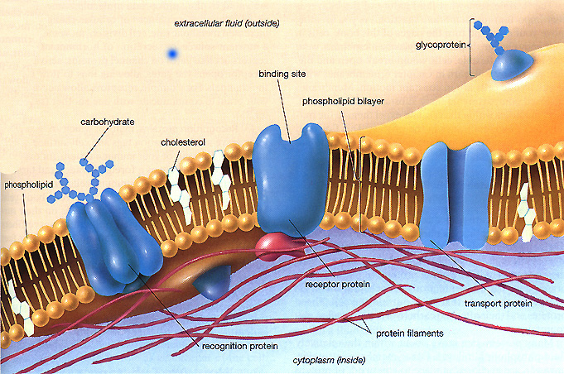

Slide 3
Cell Membrane…page 71
Allows material into and out of the cell
Semi permeable (some)
Made of a phospholipid bilayer
OSMOSIS-brings water into and out of the cell
DIFFUSION-brings other materials in/out of the cell (Oxygen, food)

Slide 4
Active transport – the movement of molecules across a cell membrane from an area of low concentration to high concentration
Low to high requires energy
Passive transport – the movement of molecules from an area of high concentration to low concentration.
High – low
does not require energy
diffusion and osmosis

