Slide 1
Groups on the Periodic Table

Slide 2
Groups on the Periodic Table…17
Groups – vertical columns
have many similarities
identifies reactivity
Periods – horizontal rows
do not have a lot in common
identifies the # of electron shells

Slide 3
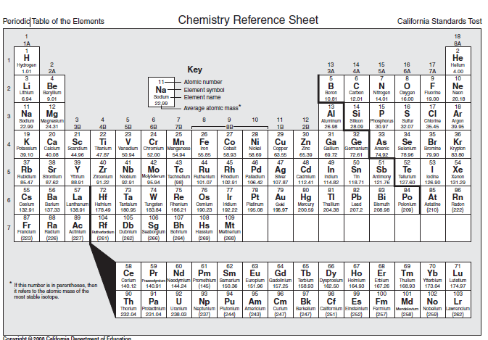

Slide 4
Valence electrons:
the electrons located in the outermost shell
helps determine reactivity of atoms
Reactivity
tendency of a substance to undergo a chemical reaction

Slide 5
ATOMS are happy if they have 8 electrons in their outside shell

Slide 6
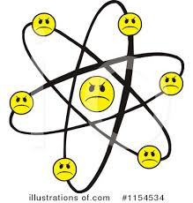
Atoms are unhappy if they do not have 8 electrons in their outside shell

Slide 7
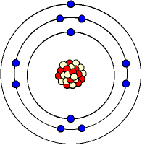
Sodium is miserable. Why?

Slide 8
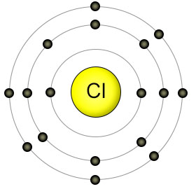
Chlorine is almost happy. It will hook up with almost any atom to get one more electron

Slide 10
KEY…17
Draw key on the front of page 17
Hydrogen
Alkali Metals
Alkaline Metals
Transition Metals
Halogens
Noble Gases

Slide 11
Attach to the front of page 17

Slide 12
ALKALI METALS
ALKALINE METALS
HALOGENS
NOBLE GASES
Back of page 17
Front of page 18

Slide 14
Mrsmarcelloscience2017.weebly.com

Slide 15
Group number –
Properties-
Examples-
Reactivity-
Valence Electrons-
Uses-

Slide 16
Alkali Metals
Group number – 1
Properties-
Examples-
Reactivity-
Valence Electrons-
Uses-
Soft, tarnish rapidly, low melting point, low density, violently react, silver, conductors
Lithium, sodium, potassium, rubidium, cesium, francium
React violently, very reactive
1
Aircrafts, salt, batteries, explosives

