Slide 1
Rocks Create a Timeline… 42

Slide 2
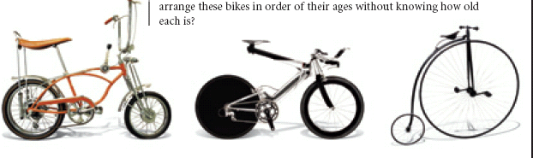

Slide 3
Relative age
Comparing something’s age to something else.
  Ex: The Himalayas are younger than the Alps.
Sedimentary

Slide 4


Relative Age
This guy
This Guy
Is
Older
Than

Slide 5
Giving a definitive number.
  Ex: The Himalayas are 30 million years old
Absolute age
Igneous rock

Slide 6
Absolute Age
This guy is 80 years old.
This guy is 24 years old.

Slide 7
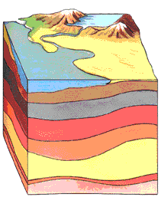
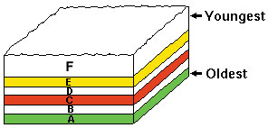
Law of Superposition
  The bottom layer is the oldest
  The top layer is the youngest

Slide 8
youngest
Oldest

Slide 9
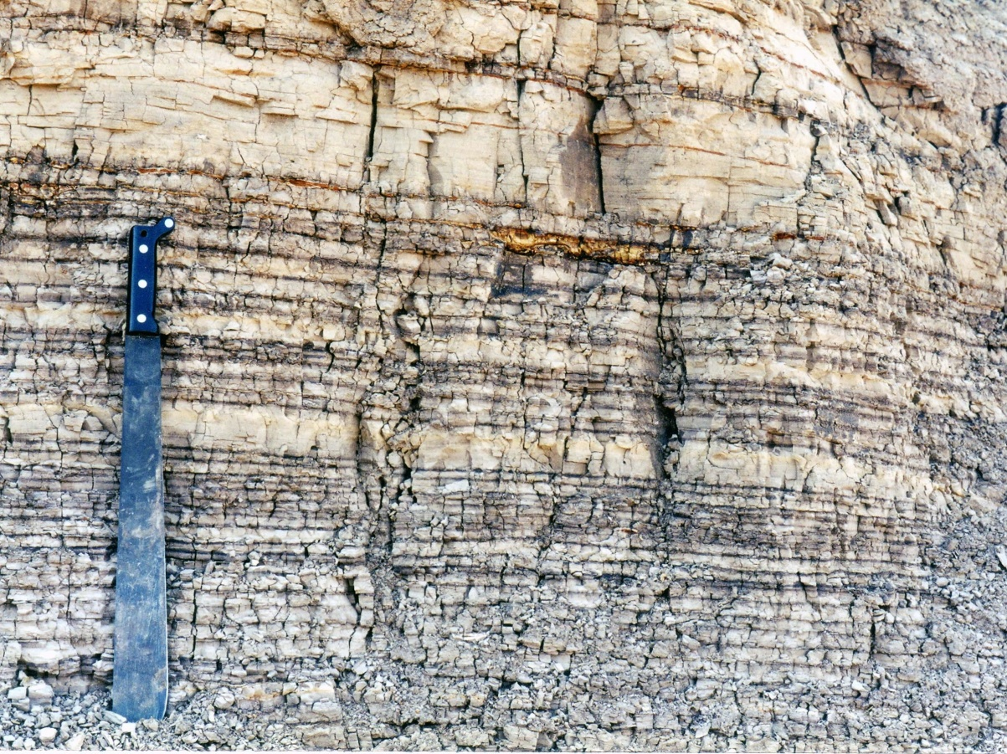
Undisturbed Layers

Slide 10
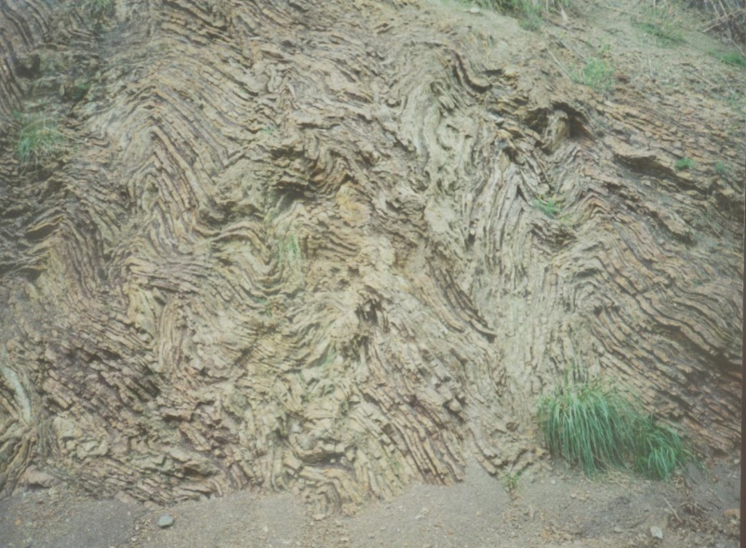
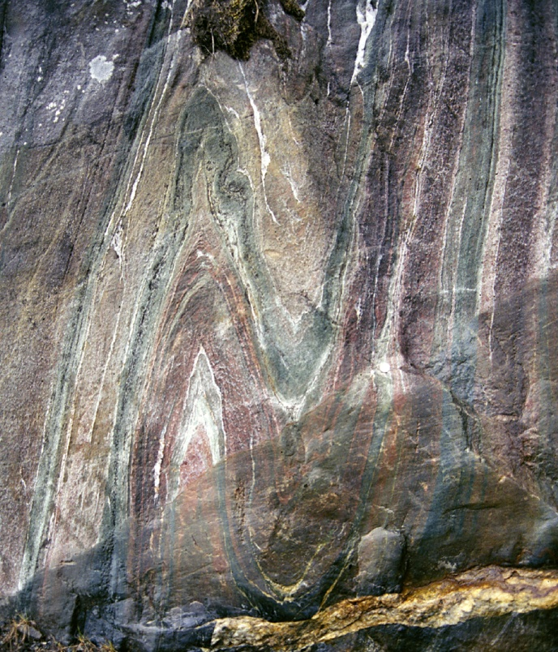
Disturbed Layers

Slide 11
Law of horizontality
  All sedimentary rocks are deposited flat initially.
  If you find them at an angle, they have been moved

Slide 12
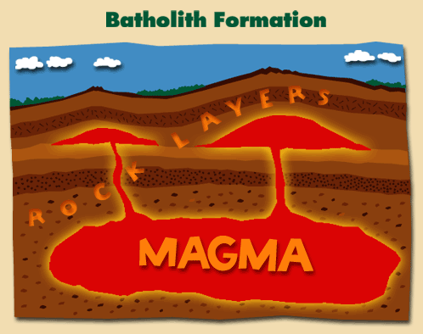
Law of Cross cutting relationship
Igneous rock is younger than the layers it cuts through

Slide 13
Youngest
Oldest

Slide 14
youngest
oldest

Slide 15
Unconformity
creates a gap in the Earth’s history
Caused by erosion

Slide 16
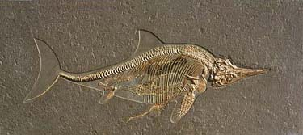
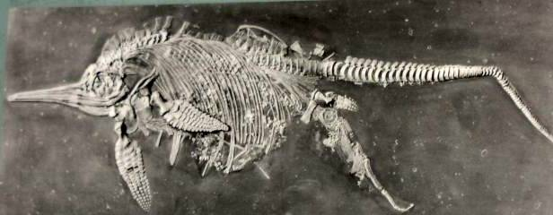
Fossils
Imprints or remains of ORGANISMS that were once alive

Slide 17
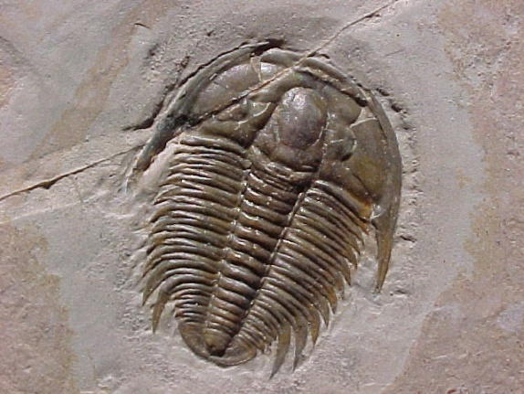
Index Fossils
Organisms that lived during a specific time and are found everywhere
IDENTIFIES THE AGE OF ROCK THEY ARE FOUND IN
Ex. Trilobite

Slide 18


Slide 19
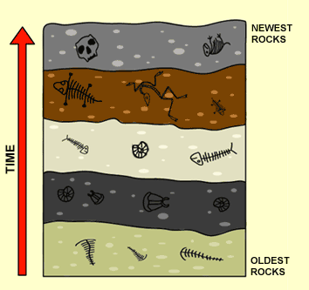
Using Superposition
Remember the aging of layers
Fossils of similar age will be found in the same layer

Slide 20
